Slide 1
Power Transmission Case Study
Max Van Huis, Lillian Wilson, Andrew Vitale
April 30, 2025
Machine Component Design MAE 353 01

Slide 2
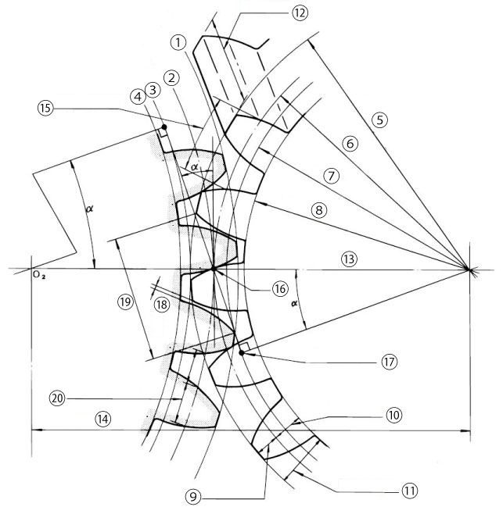
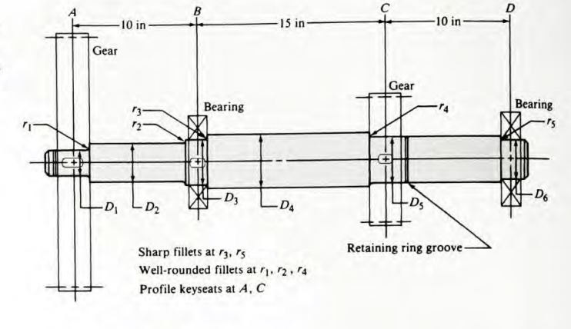
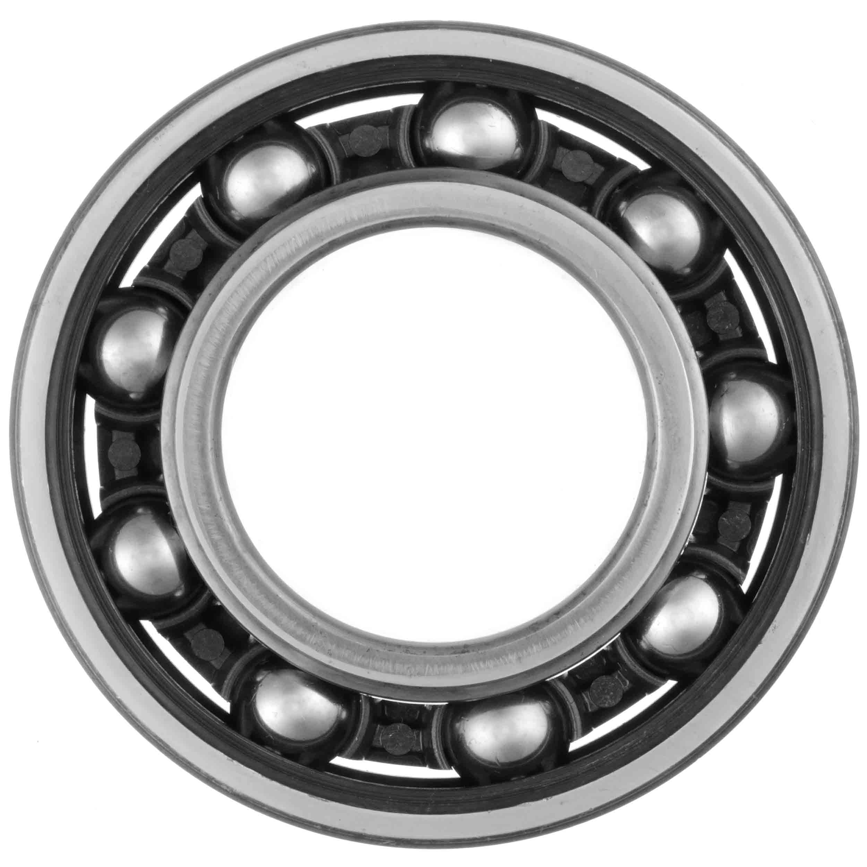
Background
We were interested in creating a gearbox that can convert a higher rpm input to a higher torque output.
Main steps were as follows:
Gear design
Shaft design and selection
Bearing selection

Slide 3
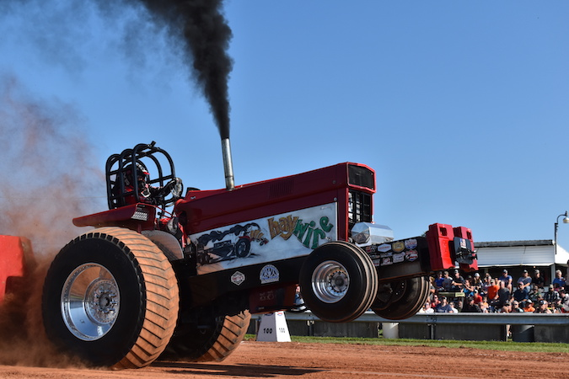
Background (continued)
Gear reducers can be found in high-torque machines
Examples include:
Agricultural machinery
Trucks
Construction machinery

Slide 4
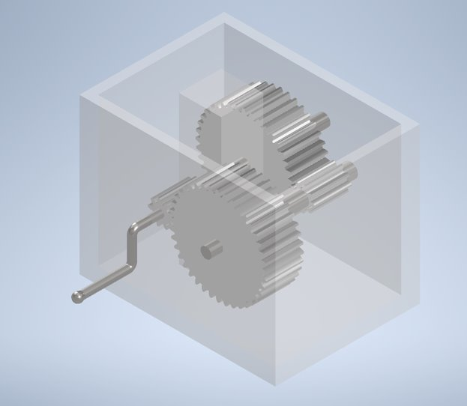
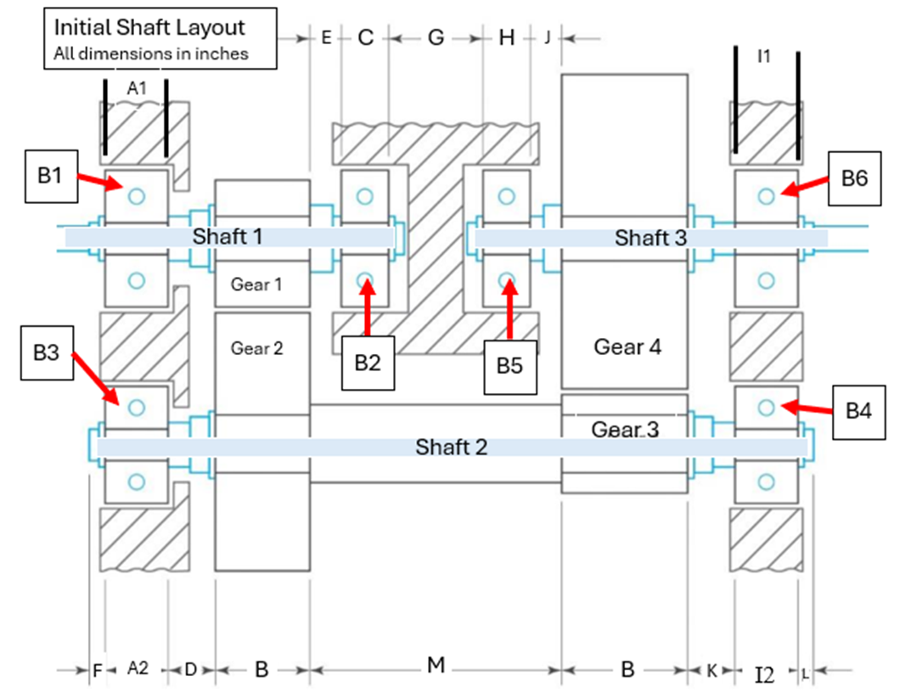
Drawings

Slide 5
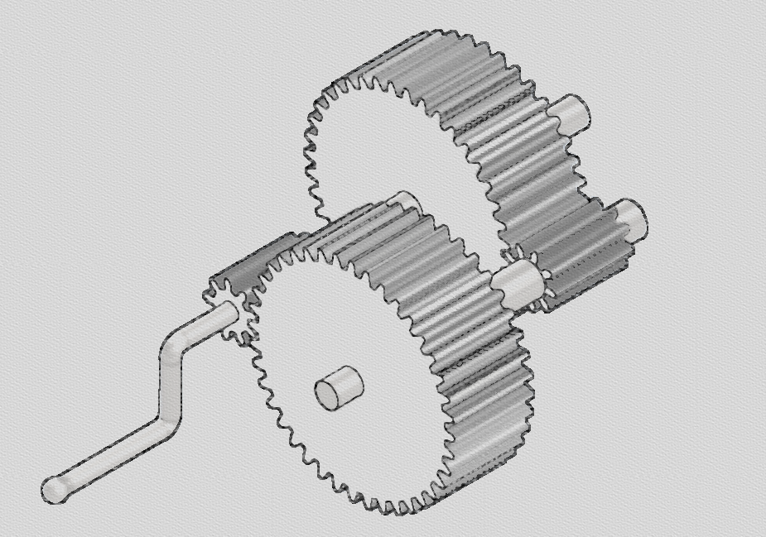
Detailed Design: Power and Torque Req.
Given Power: 17 HP
Input Speed: 1600 rpm
Output Speed: 80-85 rpm
Bearing Life: 14,000 hours

Slide 6
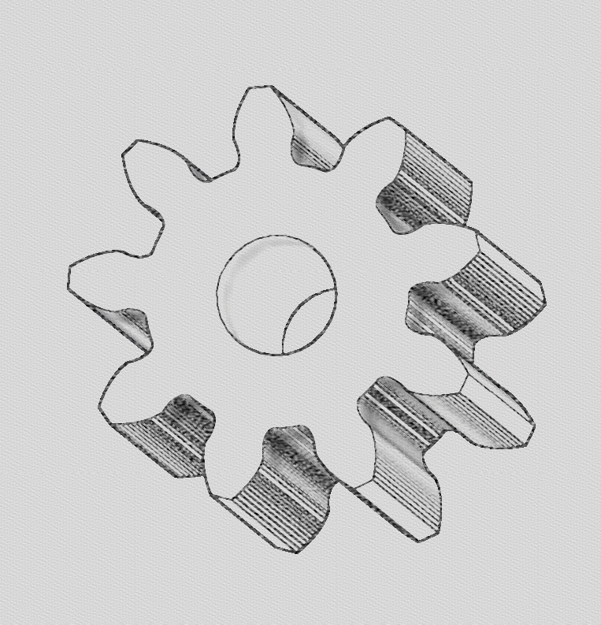
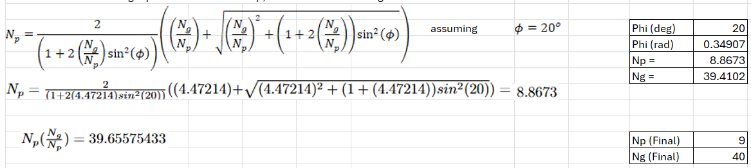
Detailed Design: Gear Specs and Forces

Slide 7
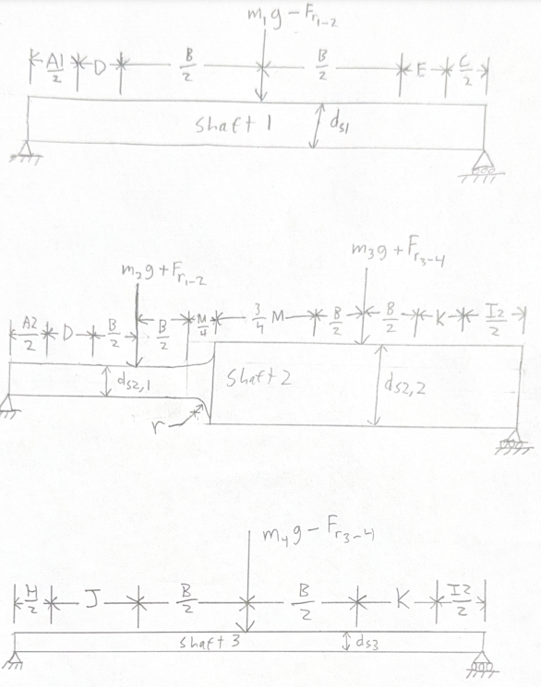
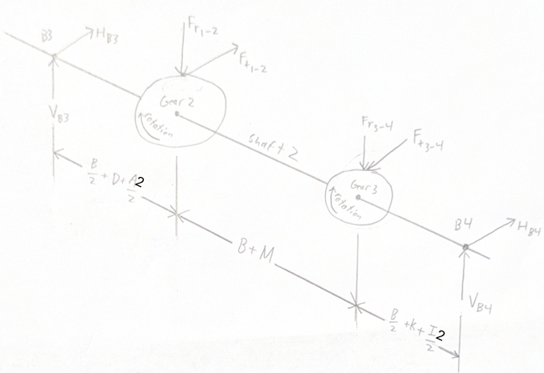
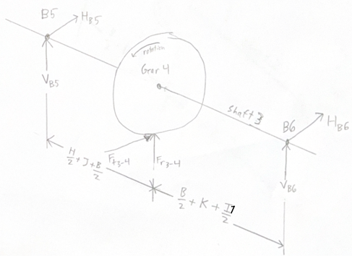
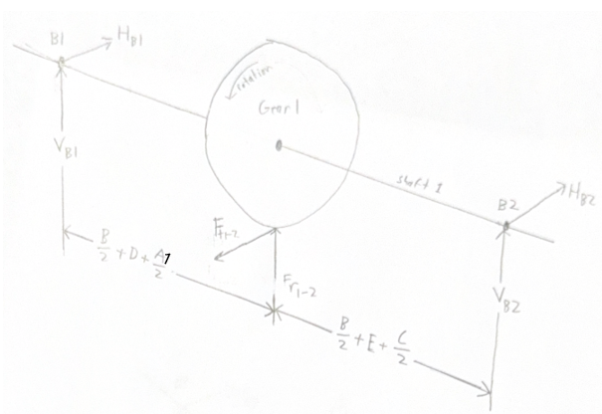
Detailed Design: Shaft Specs and Forces
Shaft | Torque
1 | 669.6406 | lb*in.
2 | 2976.181 | lb*in.
3 | 13227.47 | lb*in.
Resultant Forces at Gear Locations (Y direction)
Pinion 1 | -212.0213 | lbf
Gear 2 | 308.0698 | lbf
Pinion 3 | 967.5146 | lbf
Gear 4 | -871.4661 | lbf
Resultant Forces at Gear Locations (X direction)
Pinion 1 | -595.2395 | lbf
Gear 2 | 595.2395 | lbf
Pinion 3 | -2645.509 | lbf
Gear 4 | 2645.509 | lbf

Slide 8
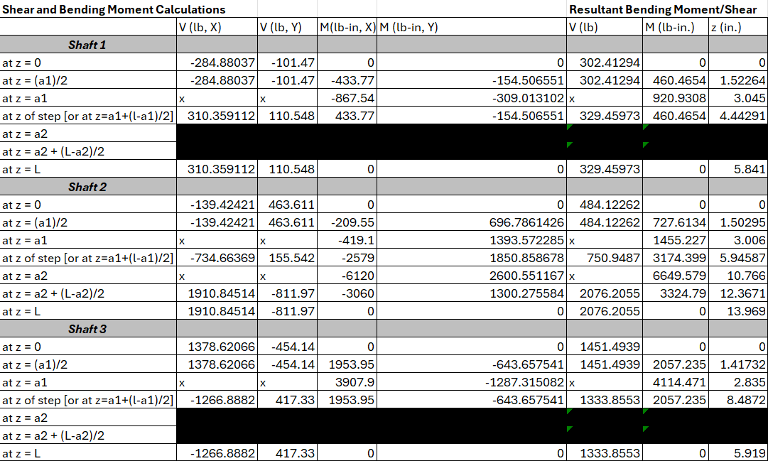
Detailed Design: Shaft Bending Moments

Slide 9
Detailed Design: Bearing Specs and Forces
Required Bearing Capacities
 | NEW | OLD
Creq (B1) | 3.64 | 3.57 | kN
Creq (B2) | 3.97 | 4.04 | kN
Creq (B3) | 3.19 | 3.12 | kN
Creq (B4) | 15.87 | 15.95 | kN
Creq (B5) | 7.20 | 7.33 | kN
Creq (B6) | 6.62 | 6.49 | kN
 | Less | More

Slide 10

Recommendations
Lower the diameter on the stepped shaft.
Use helical gears and herringbone gears
Helical gears engage more gradually than spur gears
Herringbone gears eliminate the axial thrust generated by the gears.
Use a stronger materials such as AISI 4130
Contains chromium and molybdenum as strengthening agents

Slide 11
Conclusions
We learned how tedious each step and system of the design was.
One small edit changes the entire design
Continued to develop skills on excel and using CAD software.
Excel was great for design selection changes.

Slide 12
References
Juvinall, Robert C, and Kurt M Marshek. Fundamentals of Machine Component Design. Hoboken, N, Wiley, 2020.
Picture Credit:
Khkgears.net, 2025, khkgears.net/new/images/know-about-parameters-that-determine-gear-shapes/Parameters- necessary-for-gear-design.jpg. Accessed 29 Apr. 2025.
Orleanshub.com, 2023, orleanshub.com/wp-content/uploads/2023/07/072223_Mhaywire.jpg. Accessed 29 Apr. 2025.
Principle-Eng.co.uk, 2025, principle-eng.co.uk/wp-content/uploads/2016/12/GRW-Ball-Bearings-Deep- Groove-470x470.jpg. Accessed 29 Apr. 2025.
Skyhighelearn.com, 2021, skyhighelearn.com/wp-content/uploads/2021/03/Design-of-procedure.jpg. Accessed 29 Apr. 2025.

Slide 13
Questions?

